Slide 1
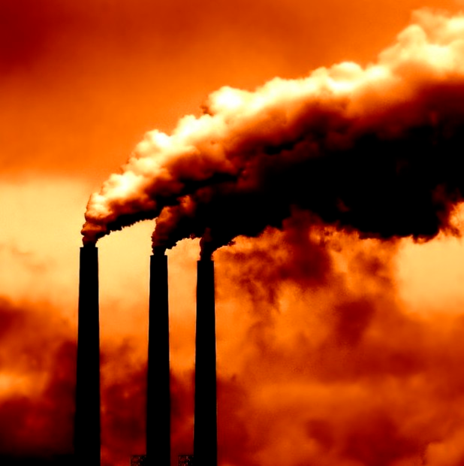
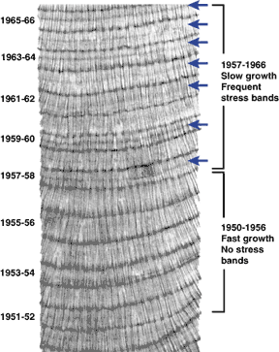
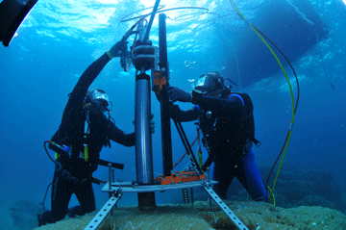
Anthropogenic aerosol emissions drive variations in Caribbean coral growth
PM_{2.5}
PM₁₀
SO₄
Lester Kwiatkowski
Notes:
Not interested in GHGs. Aerosols:
an aerosol is a colloid suspension of fine solid particles or liquid droplets in a gas. Examples are clouds, and air pollution such as smog and smoke
Not aerosol spray cans
By growth I mean linear extension and by variations i mean multi-decadal variations

Slide 2
Talk summary
The AMO, aerosols and Caribbean coral growth
Using GCMs & statistical models to resolve proximate drivers of historical AMO-coral growth correlations
The importance of anthropogenic aerosols
Informing our understanding of future Caribbean growth rates

Slide 3
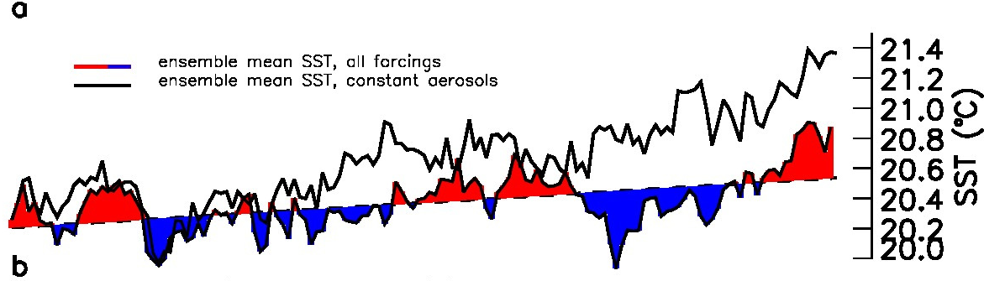
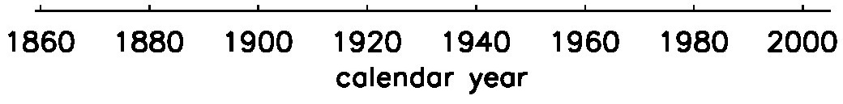
A new understanding of the AMO
A mode of North Atlantic SST variability previously thought to be internal to the ocean (Knight et al. 2005)
Redefined by Ottera (2010), Chang (2011) & Booth et al. (2012) Nature
Notes:
Describe the changes in aerosols in the late 20th C
Until recently, the prevailing consensus has been that the AMO is a mode of internal variability within the climate system²⁰. However, there is increasing evidence pointing towards external factors (volcanoes and anthropogenic aerosols) as drivers of AMO variability during the observed period. Large volcanic events are linked to cool phases in SSTs²¹ and recent work revisiting Atlantic variability in current global climate models also identifies an important role of past anthropogenic aerosol emissions in determining much of the observed multi-decadal change⁹

Slide 4
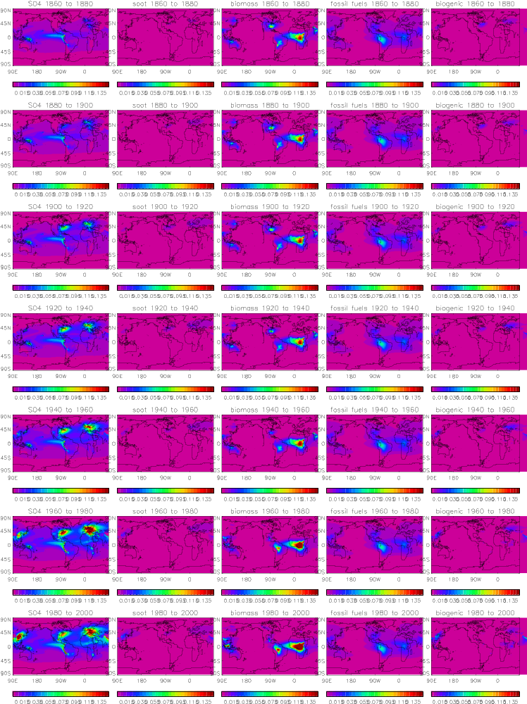
Caribbean aerosol sources and types
The importance of N. American Eastern seaboard SO₄ throughout the 20th century
The emergence of S. American industrialisation- metal smelting
Central & S. American biomass emissions
Time
0.01 0.03 0.05 0.07 0.09 0.11 0.13
Notes:
Focus peoples attention to the centre of the Maps
Maps of aerosol optical depth
Fossil fuel= Fossil fuel organic carbon

Slide 5
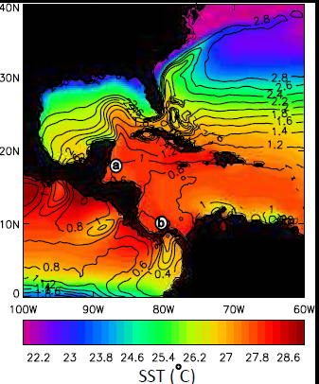
Sample sites within the GCR
Map of the Greater Caribbean Region (GCR) mean historical SST: a, Belize site
and b, Panama site. Contours give the standard deviation of the mean.
Masterchonologies:
Belize: 9 colonies of Montastraea faveolata (Carilli et al. 2010)
Panama: 77 colonies of Siderastrea siderea (Guzman et al. 2008)
Notes:
So, lets look at some actual corals as thats what were here to model...
Masterchronologies were constructed from standardized coral growth chronologies
Sourced Caribbean coral data (nothing in the NOAA repository)
Number of sites disregarded:
-single colony chronologies
-heavily influenced by land-based runoff, river plumes & other local stressors

Slide 6
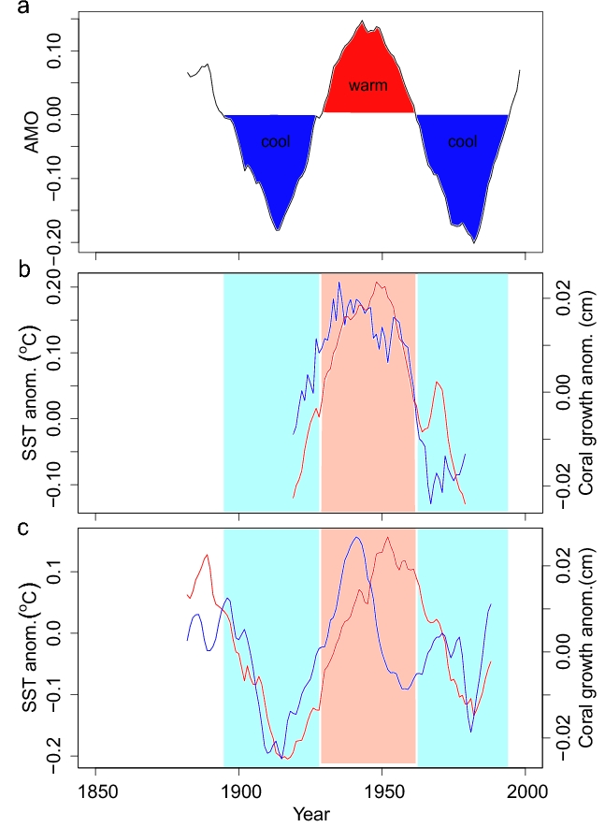
The AMO, coral growth and observational SSTs
SSTs across the Caribbean are synchronous with the AMO
Across our Caribbean sites, corals show multi-decadal signals in growth rates that have the same periodicity as the AMO-
Correlations between the AMO and coral growth parameters have been shown before: Saenger et al. (2009), Helme et al. (2011)
Notes:
Start with observations to convince people that dont believe in GCMs
SSTs and coral growth anomaliess have been constructed as per the AMO (linearly detrended and filtered to highlight multi-decadal variability
a, The 25 year filtered AMO. b-c, 25 year filtered coral growth anomalies (blue) and observed SST anomalies (red) for the b, Belize site and c, Panama site. Coral growth and SST are linearly detrended as per the definition of the AMO.

Slide 7
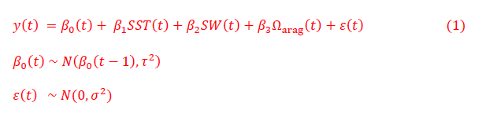
Using GCMs & statistical models to resolve proximate drivers of AMO-coral growth correlations
Times series filtered to highlight multi-decadal variability
Modified linear regressions used to systematically select the combination of GCM physical predictors (SST, SW, Ω_{arag}) that minimise the Deviance Information Criterion (DIC)
  Force statistical models with the GCM physical predictors derived from fixed anthropogenic aerosol emission ensemble runs
Notes:
This is effectively a linear model with a time-dependent intercept β₀(t). The intercept is assumed random, where the current value is centred on the previous one. The random intercept accounts for auto-correlation in the response while allowing for predictor effects to be assessed through the significance in β_{i}.

Slide 8
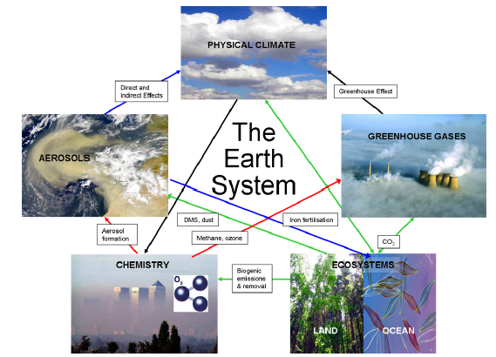
Our GCM: The HadGEM2-ES Earth System Model
The Hadley Centre’s model for the fifth IPCC assessment report (AR5)
Improved aerosol
scheme:
More aerosol species included (8)
Direct (radiation) & indirect (cloud droplet number) effects now included
Aerosols coupled to vegetation scheme & ocean model (same as Booth et al. (2012))
Earth system coupling feedbacks
Collins et al. (2011)
Notes:
The key point here is that HADGEM2 has improved the aerosol scheme
Same model used by Booth et al although their findings have been seen in other CMIP5 GCMs (GFDL)

Slide 9
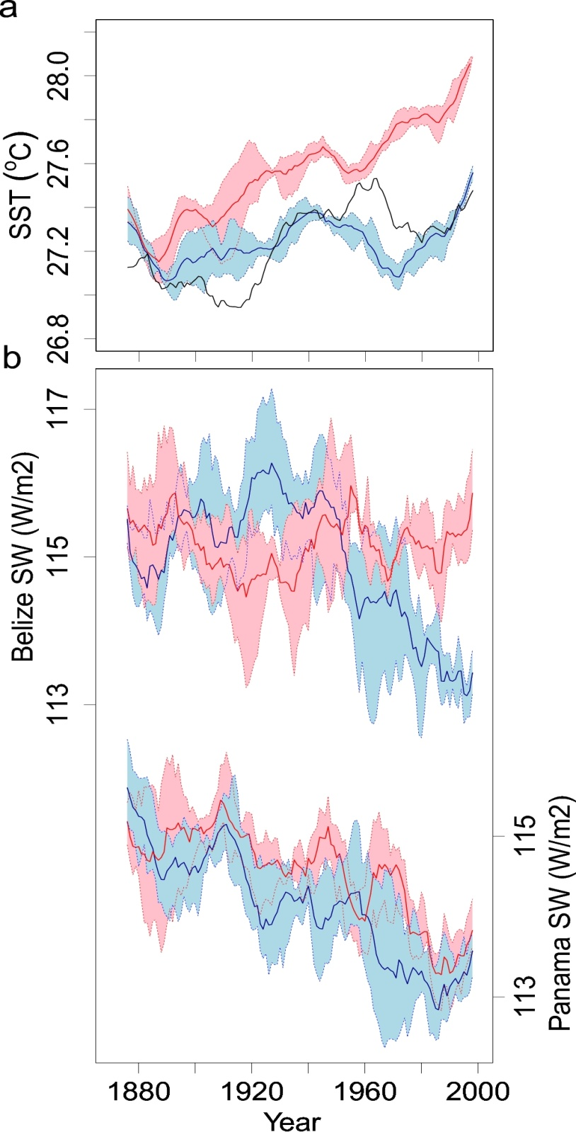
The importance of anthropogenic aerosols to the physical predictors
HadGEM2-ES reasonably recreates the multi-decadal Caribbean SST variability seen in observational record
With anthropogenic aerosols fixed at pre-industrial levels it does not
Strong influence of aerosols on SW at Belize site post 1960
Little influence of aerosols on SW at the Panama site (limited dispersal from US Eastern seaboard)
Notes:
Global Earth System Models neither contain the relevant processes, or physical resolution to accurately simulate coastal ocean conditions, consequently modelled Caribbean average, rather than local SSTs were utilised in statistical models. Due to the lack of observational data it is not possible to assess the extent to which localised solar irradiance is historically representative of that observed at a regional scale. However, the limited atmospheric dispersal and lifetime of aerosols would suggest that coherence between regional and local irradiance in the Caribbean is unlikely. We therefore chose to use localised irradiance outputs in our models.
Fits between model and obs are better over the larger N. Atlantic region
Model ensemble uncertainty is shown bounded by dashed lines and variables are 13 year filtered

Slide 10
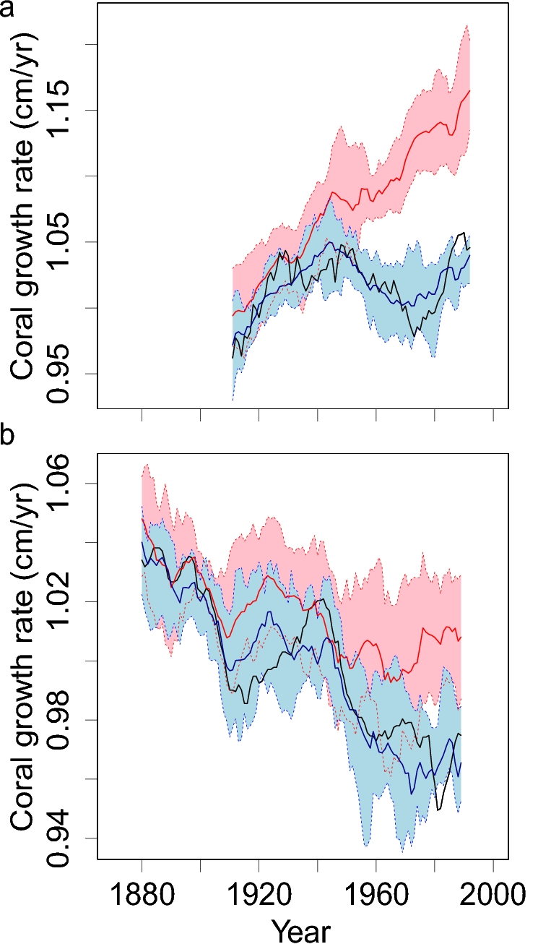
The influence of anthropogenic aerosols on statistical models
Post-1950 “fixed aerosol” models increasingly fail to capture observational coral growth rates and diverge from the “all forcings” models because of the greater role of anthropogenic aerosols in this period
Results more significant for the Belize site
Post 1950, anthropogenic aerosols appear to have suppressed coral growth rates, through aerosol-driven reductions in SW and SST
Belize
Panama
Notes:
Be aware that the plot here is from the original paper submission and does not use the revised statistical model therefore Panama looks better than it actually is

Slide 11
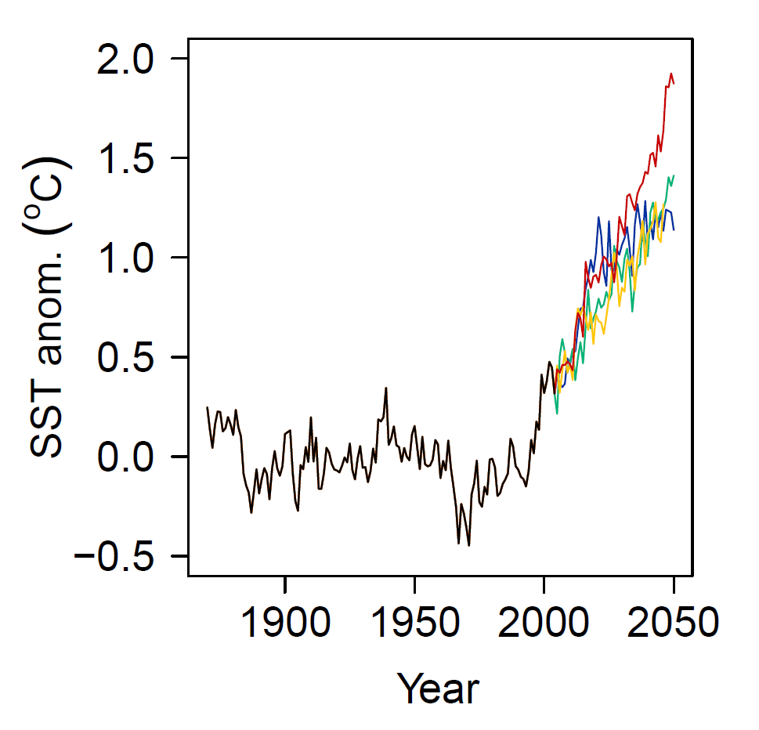
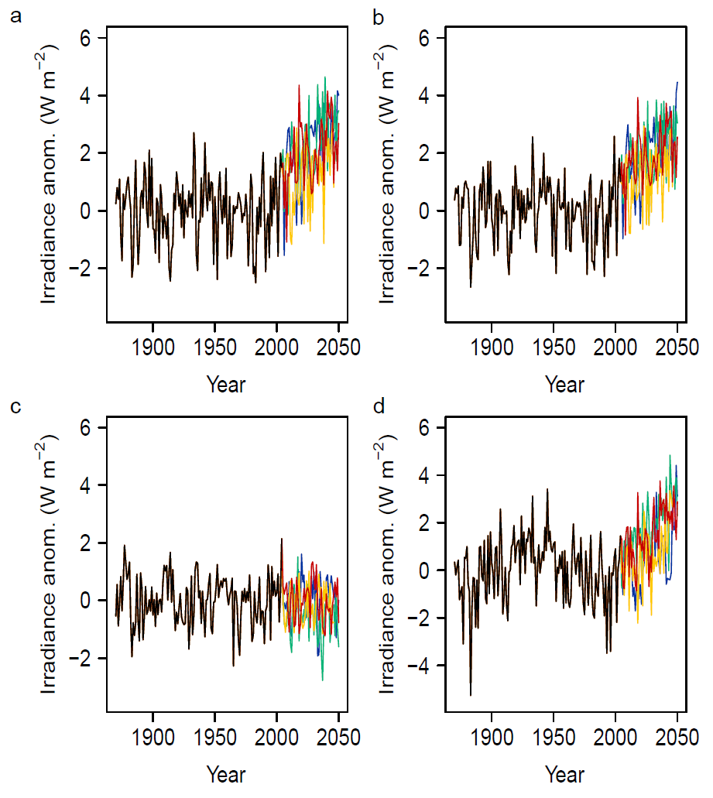
Informing our understanding of future Caribbean coral growth: HadGEM2-ES SST and irradiance projections
Belize
Panama
Limited projected multi-decadal variability in SSTs and SW but projections lack volcanism
Historical multi-decadal SST variability dwarfed by the influence of global warming on projected SST anomalies
Irradiance anomalies generally ↑ across the Caribbean (greater anti-air pollution policies), except in the south (e.g. Panama)
Notes:
Explain why we decide to do future projections
Projections obviously lack volcanism
SW increase in most of Carib
Note these SST anomalies have been taken from historical linearly detrended SSTs
SW figure on left=belize right =panama

Slide 12
Conclusions
Corals across the Caribbean show periodicity in growth rates synchronous with the AMO/aerosols
Aerosol induced changes in SSTs and irradiance appear predominately driven by volcanic activity in the early 20th C. and anthropogenic SO₄ in the later 20th C.
Historical coral growth rates can be well modelled with HadGEM2-ES SST and SW outputs
Statistical models of coral growth using “time varying” and “fixed” anthropogenic aerosol emission GCM outputs diverge in the mid-late 20th C.
Our Enhanced historical understanding suggests regional aerosol emissions have the potential to decouple preconceived relationships between atmospheric [CO₂] and impacts on coral growth

Slide 13
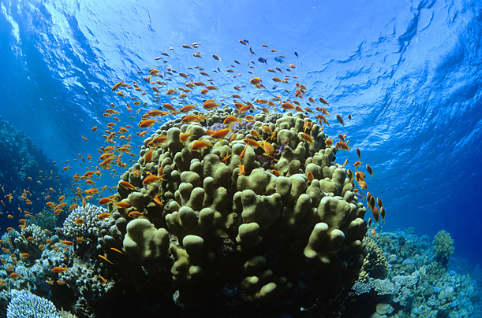


Any Questions?
Thanks,
Peter Cox (University of Exeter)
Paul Halloran (Met Office)
Peter Mumby (University of Queensland)
Theo Economou (University of Exeter)
Ben Booth (Met Office)
Jessica Carilli (ANSTO)
Hector Guzman(Smithsonian Tropical Research Institute)
Funded by NERC, the University of Exeter, and the EU FORCE project.

Slide 15
This is effectively a linear model with a time-dependent intercept β₀(t). The intercept is assumed random, where the current value is centred on the previous one. The random intercept accounts for auto-correlation in the response while allowing for predictor effects to be assessed through the significance in β_{i}.

Slide 16
Informing our understanding of future Caribbean growth rates
It is not sensible to force our statistical models with future GCM outputs however:
Aerosols and or other regional factors have the potential to decouple any preconceived relationships between global radiative forcing and impacts on coral growth
CMIP5 model RCPs use different aerosol emission scenarios which show strong regional differences
It’s likely not just the absolute [CO₂] that corals care about but how you get to that [CO₂]
Notes:
Not sensible because- the known importance of bleaching and other anthropogenic effects in the future, the range of past variability is <<

Slide 17
Statistical model parameter estimates. Estimates (posterior distribution means) for SST SW and Ω_{arag} parameters
Site | Parameter | Estimate | Standard Error | 95% Confidence/Credible Interval
Panama | SST | 0.003 | 0.003 | [-0.003,0.008]
 | SW | -0.005 | 0.004 | [-0.013,0.003]
Belize | SST | 0.008 | 0.005 | [0.001,0.018]
 | SW | 0.020 | 0.009 | [0.002,0.040]
 | Ω_{arag} | -0.024 | 0.015 | [-0.051,0.009]

Slide 18
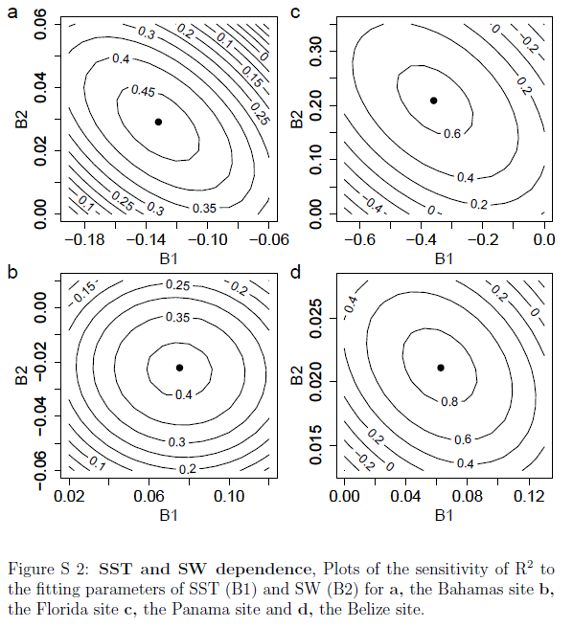
Covariance issues
Notes:
Likelihood ratio tests were performed on the statistical models containing
only SST and both SST and solar irradiance. Across all sites the inclusion of
irradiance significantly (p<0.001) improved model fit. s such coral growth
has a well defined SST and solar irradiance dependence. This is further
shown in Fig. S2 where r2 contours are shown to converge to an optimal loci
indicating that SST and solar irradiance dependencies are to some extent
separable.

Slide 19
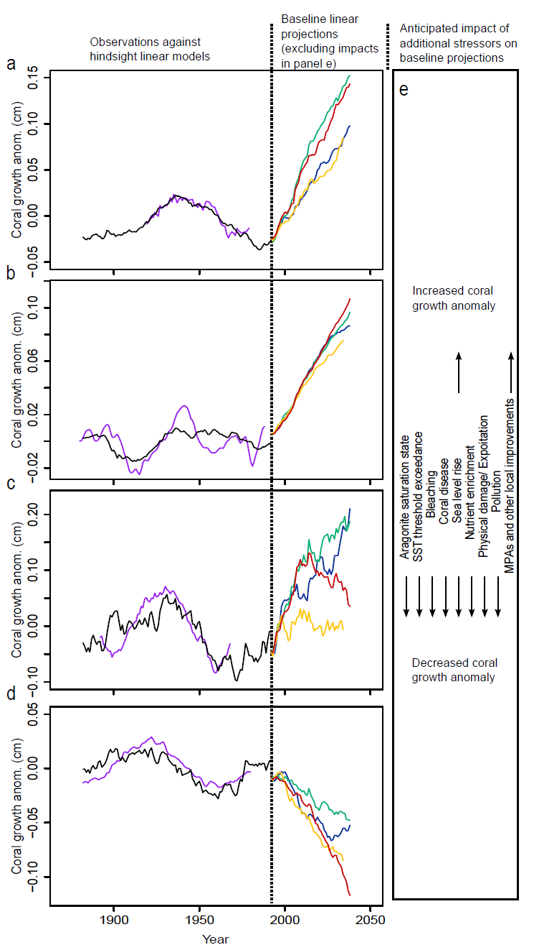
Notes:
A=belize b =panama c=florida d=bahamas

Slide 20
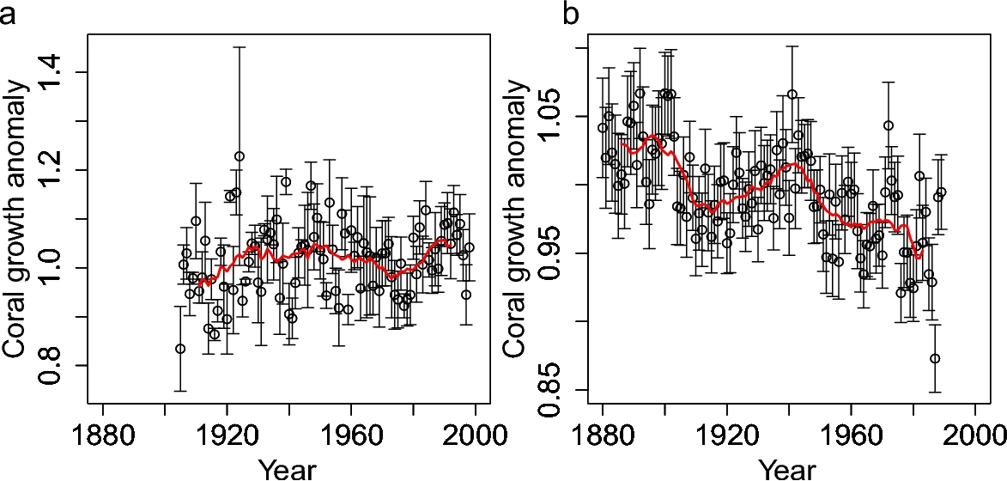
Coral growth uncertainty. Coral growth anomalies ± the standard error of the mean (SEM) from the a, Belize and b, Panama master chronologies. 13 year filtered anomalies are shown in red.

Slide 21
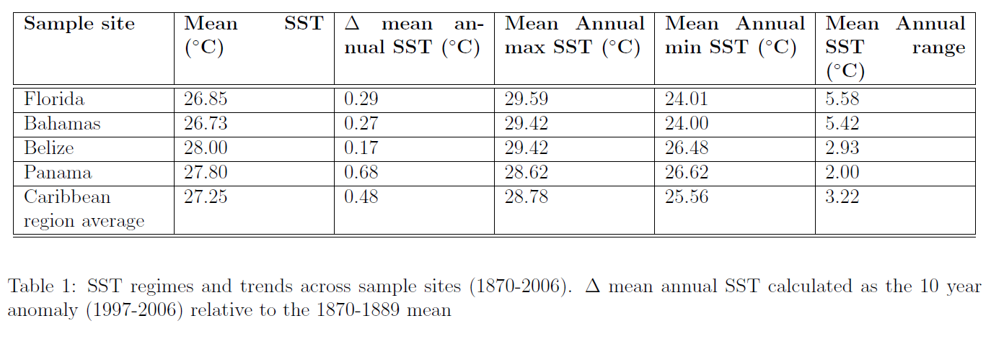
Caribbean SST regimes
Notes:
Insert sst table, hand out mind expanding mushrooms, teaching granny to suck eggs

Slide 22
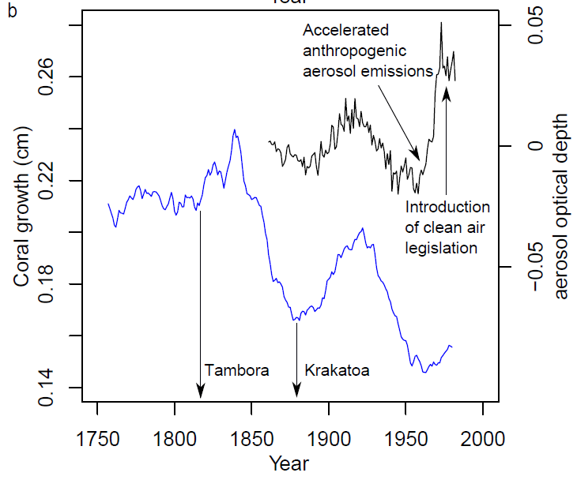
Northern Caribbean?

Slide 23
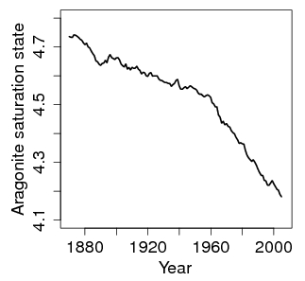
Caribbean average Ω_{arag}
Within HadGEM2-ES, aragonite saturation state is calculated from dissolved carbon and alkalinity concentrations, temperature and salinity, following Peng et al. (1987), and assuming the calcium concentration to be in a fixed ratio with salinity. The physical and chemical fields used within the carbonate chemistry calculation are all simulated interactively within the HadGEM2-ES model; the CO₂ partial pressure calculated contemporaneously with the saturation state has been shown to validate well at the Bermuda Atlantic Time-Series (BATS), and spatially against observations.

Slide 24
Model | Historical | RCP 2.6 | RCP 4.5 | RCP 6.0 | RCP 8.5
CanESM2 | 5 | 5 | 5 | NA | 5
CCSM4 | 5 | 5 | 5 | 5 | 5
cnrm-cm5 | 10 | 1 | 1 | NA | 5
CSIRO-Mk3-6-0 | 10 | 10 | 10 | 10 | 10
GFDL-ESM2G | 1 | 1 | 1 | 1 | 1
GISS-E2-R | 16 | 3 | 15 | 3 | 3
HadGEM2-ES | 4 | 4 | 4 | 4 | 4
inmcm4 | 1 | NA | 1 | NA | 1
IPSL-CM5A-LR | 4 | 3 | 4 | 1 | 4
IPSL-CM5A-MR | 1 | 1 | 1 | NA | 1
MIROC5 | 4 | 3 | 3 | 1 | 3
MPI-ESM-LR | 3 | 3 | 3 | NA | 3
MRI-CGCM3 | 5 | 1 | 1 | 1 | 1
NorESM1-M | 3 | 1 | 1 | 1 | 1

Slide 25
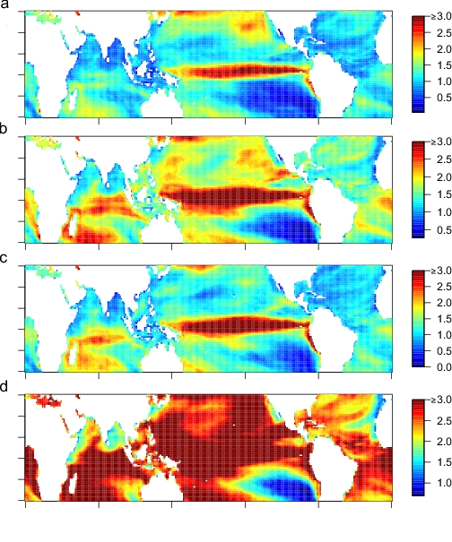
Annual mean degree heating month (DHM) values from 2040-2049 for (a) RCP 2.6, (b) RCP 4.5, (c) RCP 6.0 and (d) RCP 8.5. Outputs utilise uniform prior weighting of GCMs.

Slide 26
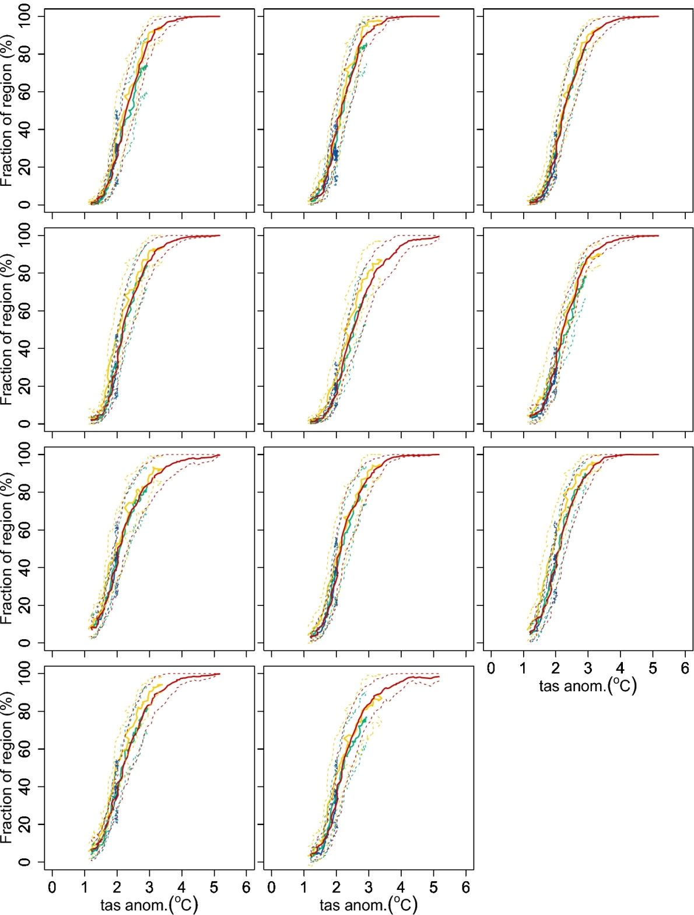
Fraction of the (a) Caribbean, (b) Central Indian Ocean, (c) Central Pacific, (d) East Pacific, (e) Great Barrier Reef, (f) Middle East, (g) Micronesia, (h) Polynesia, (i) South East Asia, (j) Western Australia, and (k) West Indian Ocean regions showing severe (DHM>2) coral bleaching against the mean near surface temperature (TAS) anomalies associated with RCP 2.6 (blue), RCP 4.5 (green), RCP 6.0 (yellow) and RCP 8.5 (red). Outputs utilise uniform prior weighting of GCMs and are 10 year filtered. Anomalies are calculated relative to the 1860-1900 mean of each GCM and 95% confidence intervals are shown with dashed lines.

Slide 27
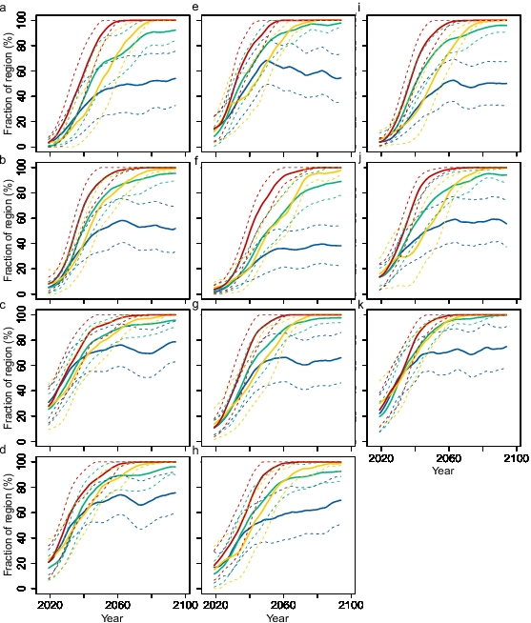
Fraction of the (a) Caribbean, (b) Central Indian Ocean, (c) Central Pacific, (d) East Pacific, (e) Great Barrier Reef, (f) Middle East, (g) Micronesia, (h) Polynesia, (i) South East Asia, (j) Western Australia, and (k) West Indian Ocean regions with at least 2 severe (DHM>2) coral bleaching events in the previous decade for RCP 2.6 (blue), RCP 4.5 (green), RCP 6.0 (yellow) and RCP 8.5 (red). Outputs utilise uniform prior weighting of GCMs and are 10 year filtered. Dashed lines show 95% confidence intervals. Dashed lines show 95% confidence intervals.

Slide 28
0.01 0.03 0.05 0.07 0.09 0.11 0.13

